Slide 1

Calculator and Text Editor
Task - 2

Slide 2


 | Calculator and Text Editor
 | LMS Username | Name | Batch
 | 2113a53223 | DEEPAK L | A53
 | 2113a53241 | KISHORE C D | A53
 | 2113a53215 | ARAVIND B | A53
 | 2113a53217 | ARUVEZHILAN R V A

Slide 3

Task - 2
Create various Front End Programs
Draw and design a uniform front end code for calculator
Draw and design a interactive front end code for text-editor
Evaluation Metric:
100% Completion of the above tasks
Learning Outcome
Get to know about concepts of project bucketing
Knowing about various frontend development framework like angular, vue,react
Know about various react topics like components, props, state, life cycle etc.

Slide 4

Step-Wise Description
Step 1: Start with creating a basic HTML page.
Step 2: Add the HTML elements and attributes necessary for creating the form elements.
Step 3: Add the text boxes and buttons for the calculator.
Step 4: Create a function for the calculator that will take the input from the text boxes and perform the desired calculations.
Step 5: Add a JavaScript code to the HTML page that will execute the calculator function when the buttons are clicked
.Step 6: Test the calculator to ensure it is working as expected.

Slide 5
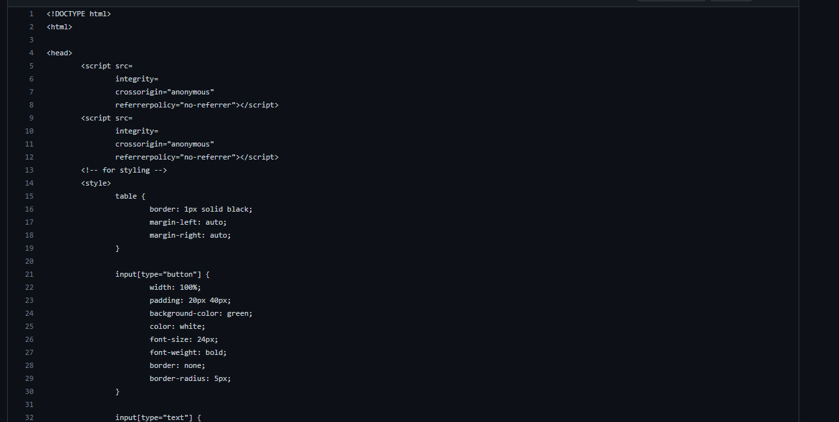
Calculator code :

Slide 6
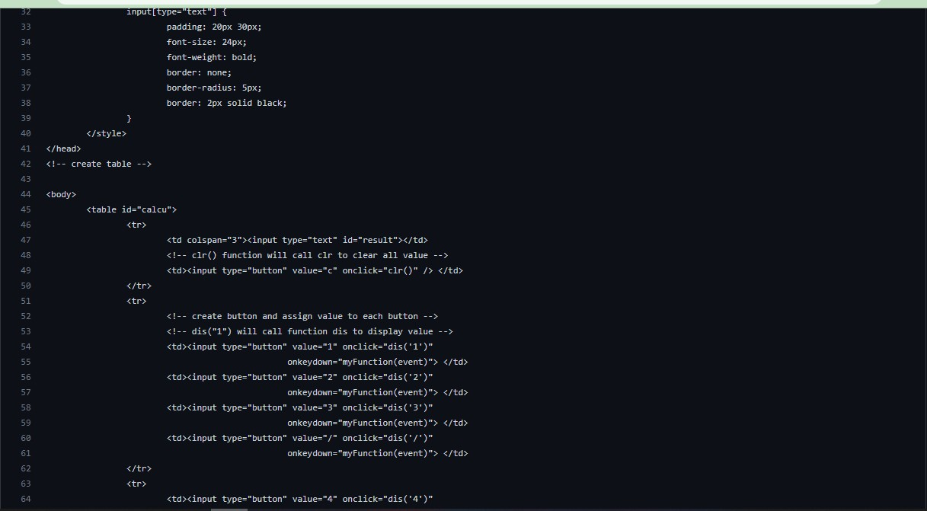

Slide 7
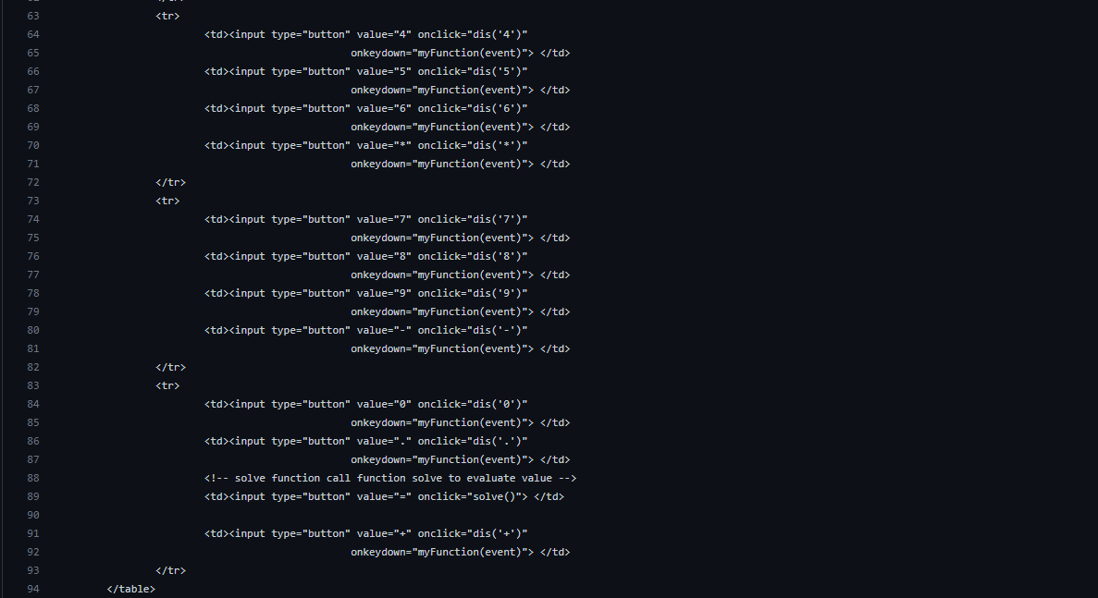

Slide 8
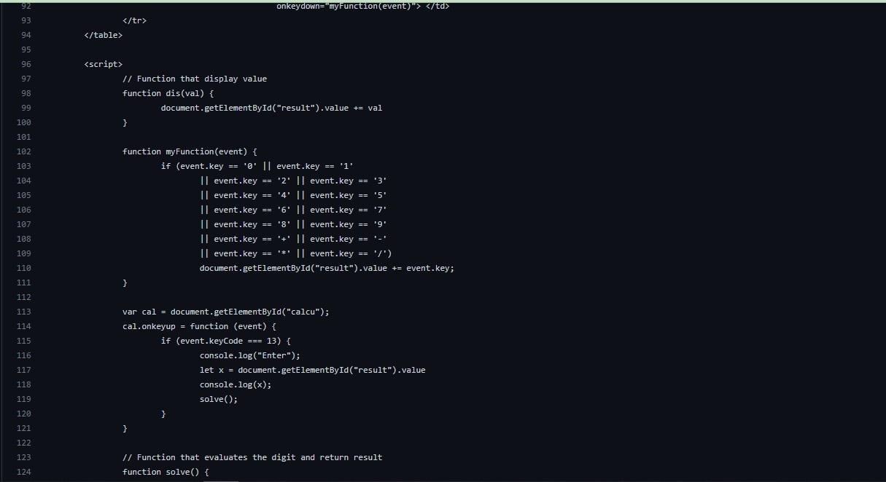

Slide 9
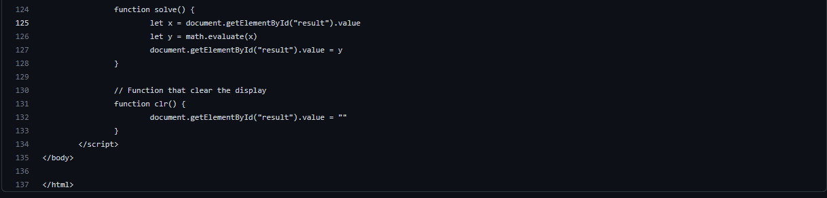

Slide 10
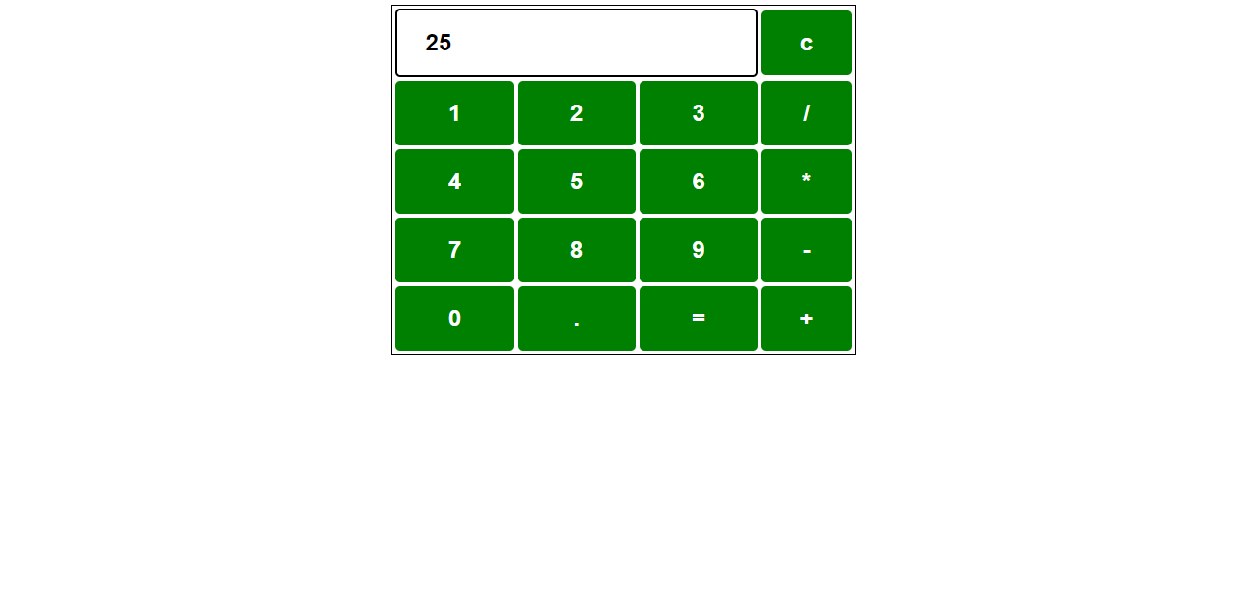
Output:

Slide 11
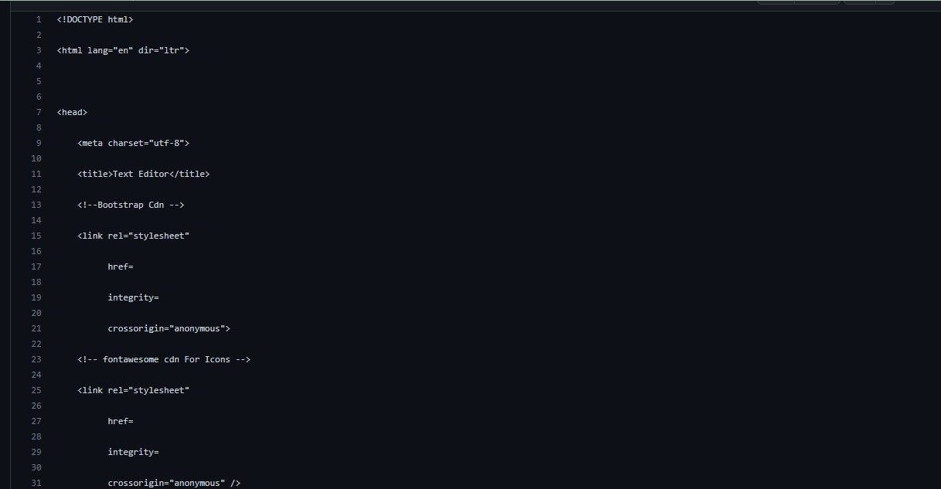
Text Editor:

Slide 12
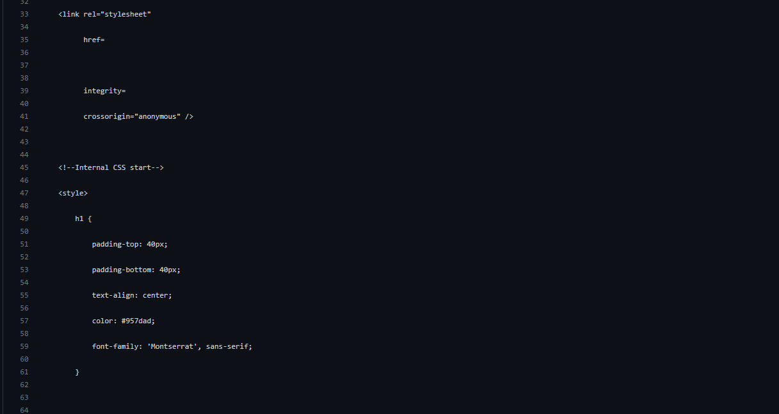

Slide 13
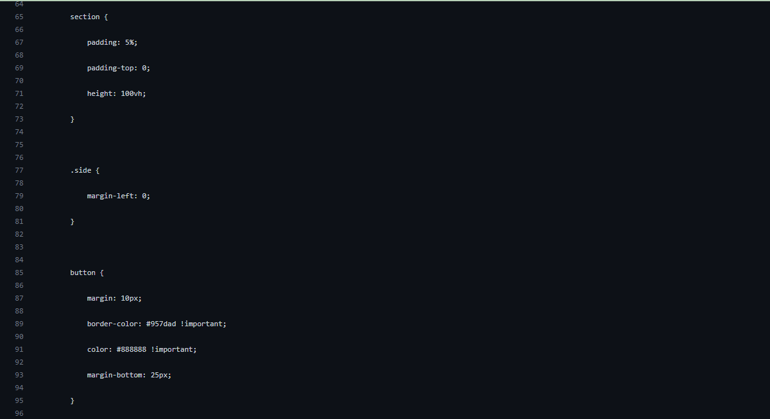

Slide 14
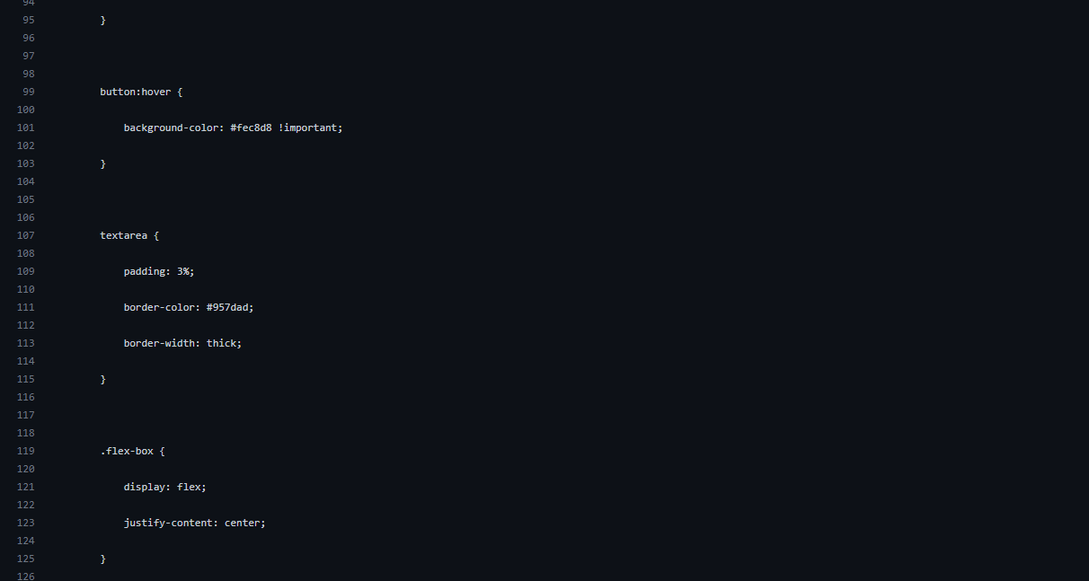

Slide 15
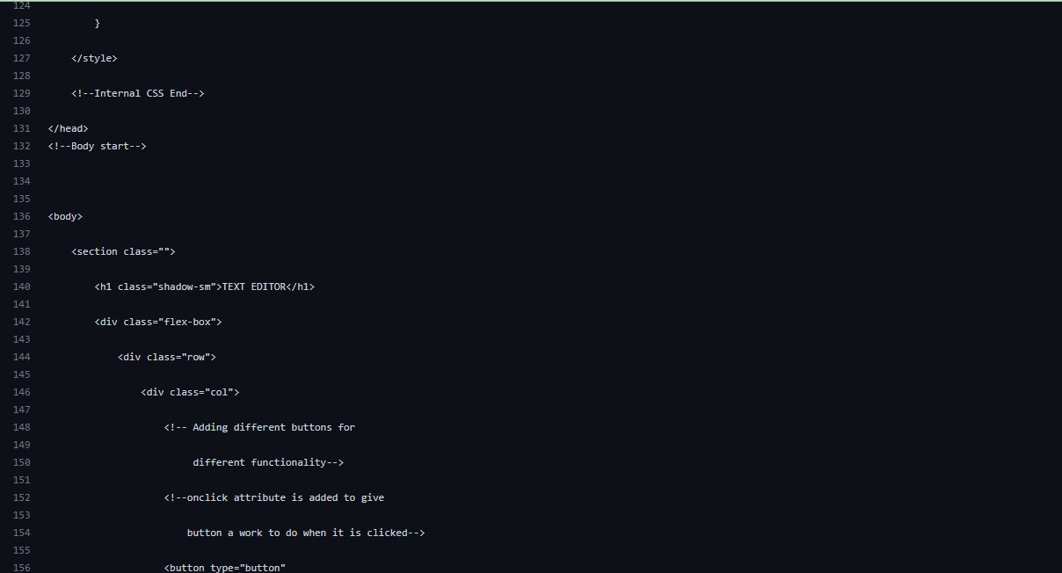

Slide 16
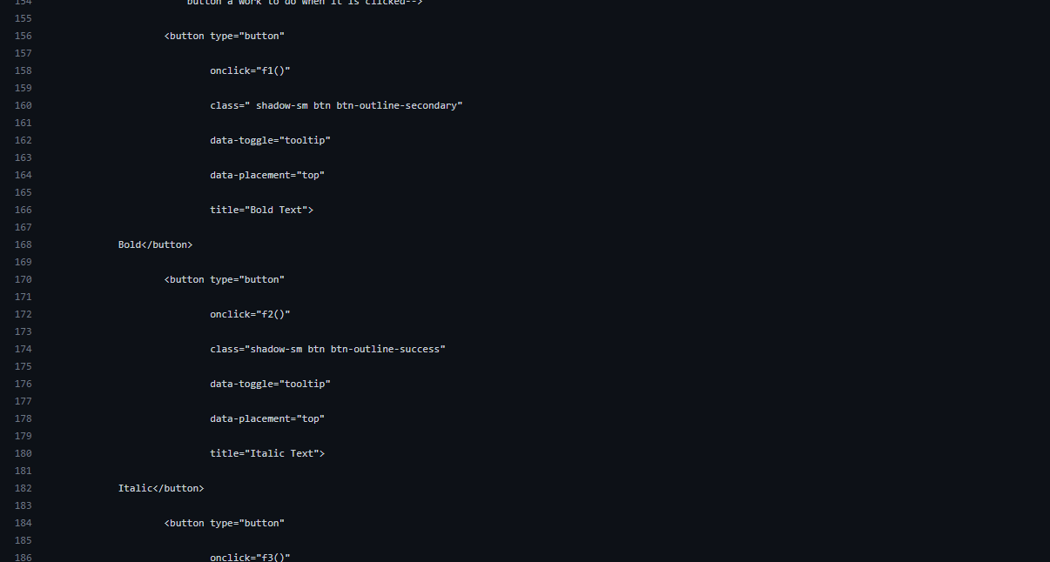

Slide 17
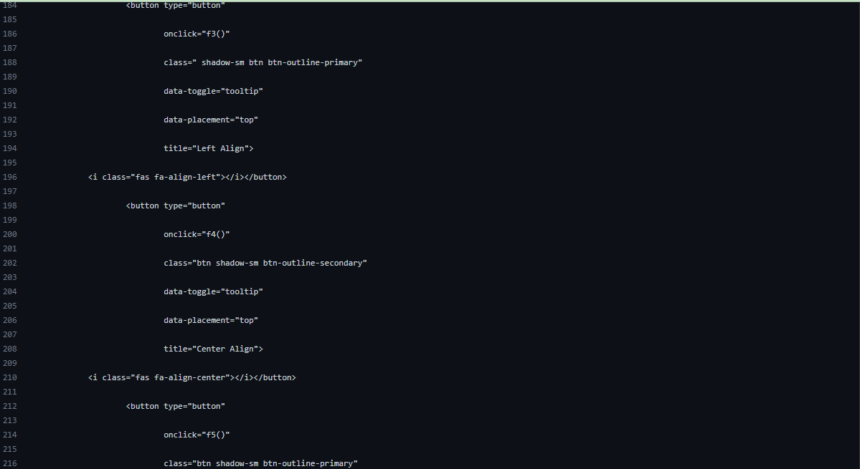

Slide 18
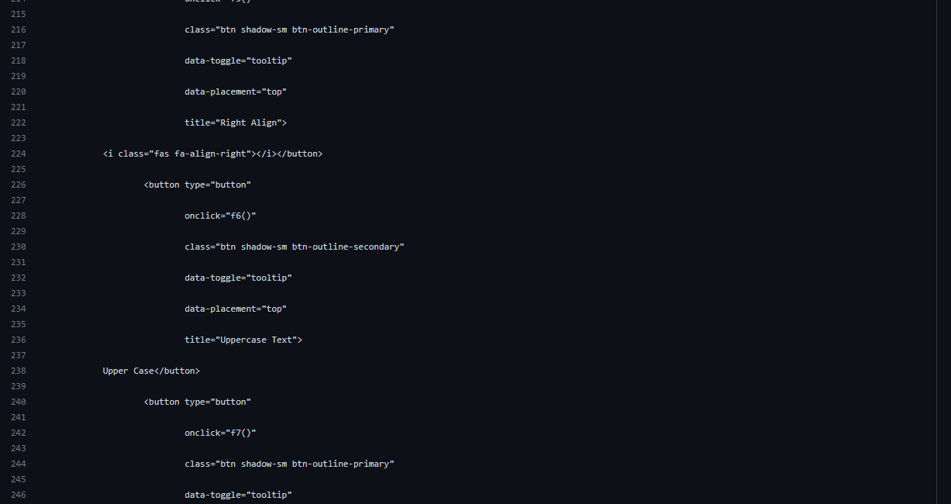

Slide 19
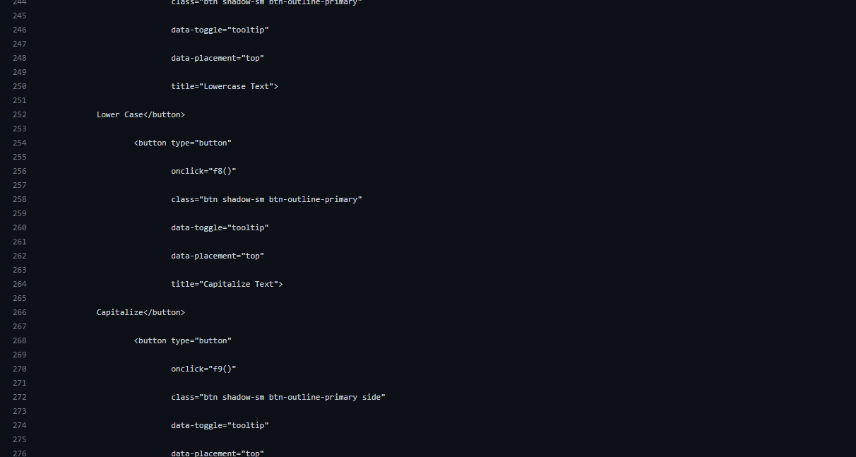

Slide 20
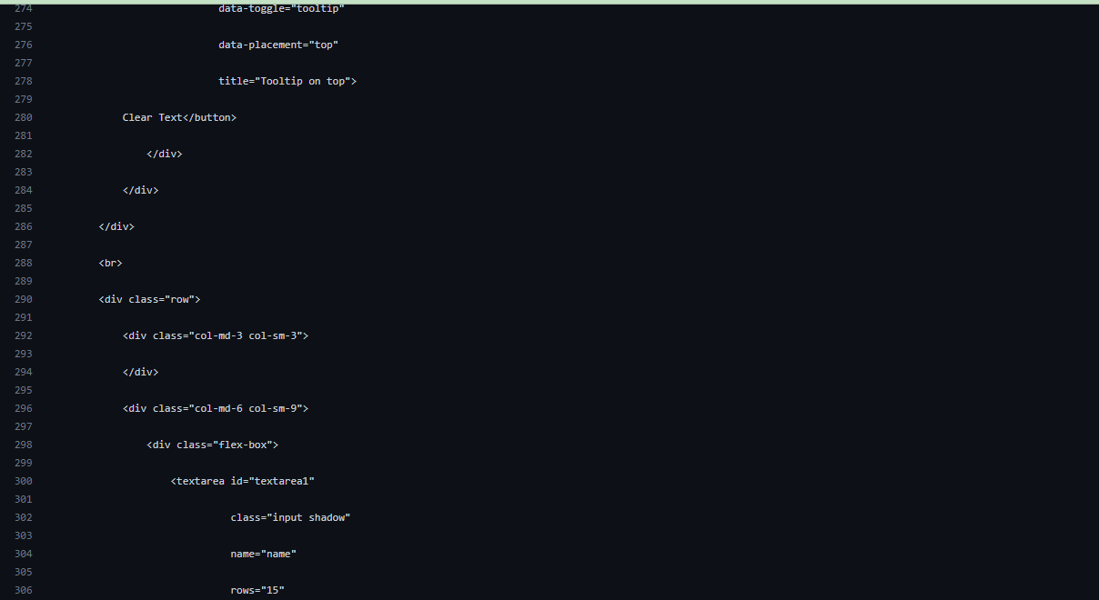

Slide 21
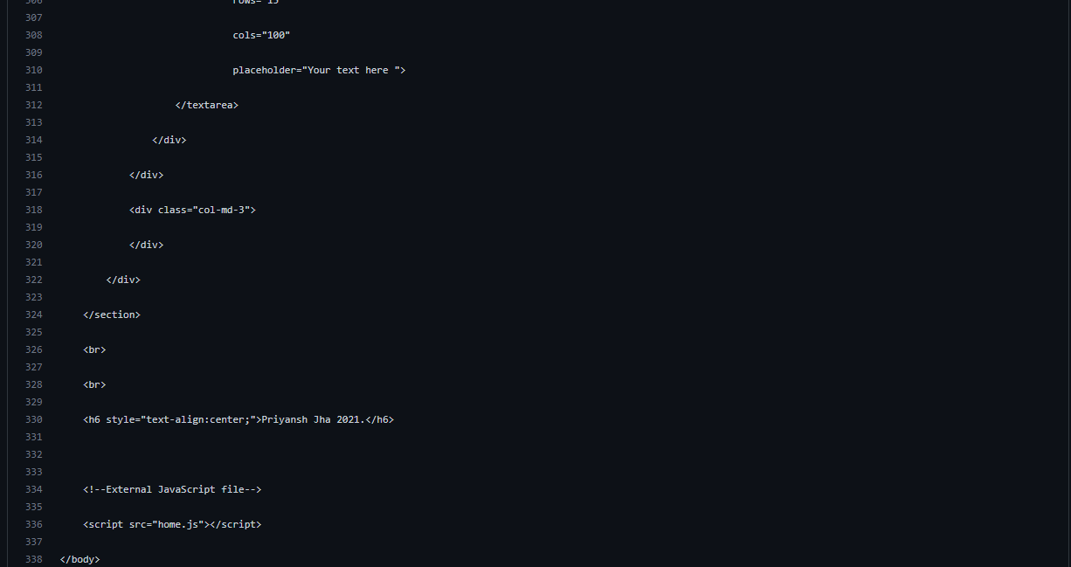

Slide 22
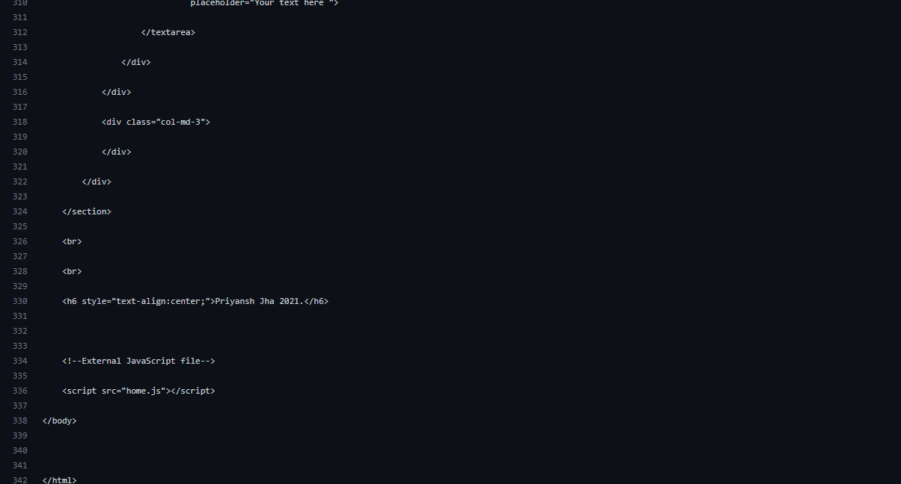

Slide 23
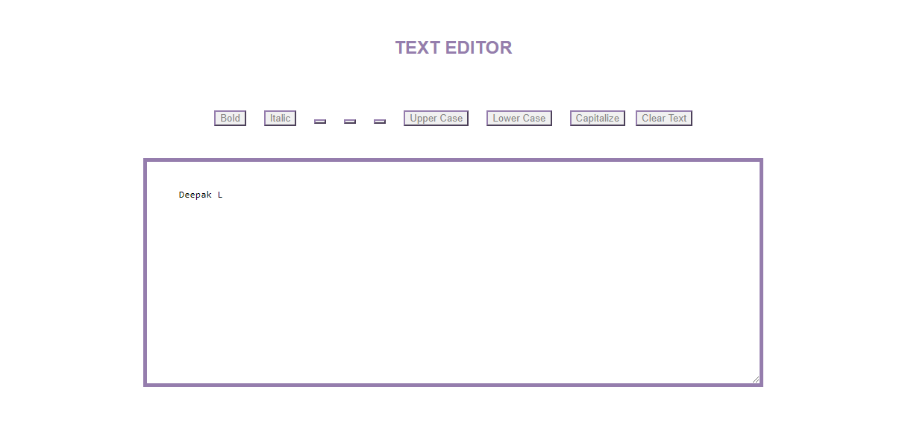
Output:

Slide 24


Assessment Parameter
Setup Project for Calculator
project
Setup basic structure of text- editor project
Create a main component with the outer structure of calculator
Check-List
Create main component with all feature buttons
Create a button component with on click handler
Create a json object to store data for text editor
Create a ` evaluateExpresion` function to evaluate value
Push both code to github

Slide 25


Submission Github
https://github.com/Massdeepak/ Group_A53_7

Slide 26


